Slide 1
Hyperledger Fabric a Distributed Operating System for Permissioned Blockchains
Marko Vukolić, IBM Research - Zurich
February 1, 2018
TU Delft
Blockchain Lab Launch

Slide 2





What is a Blockchain?
A chain (sequence, typically a hash chain) of blocks of transactions
Each block consists of a number of (ordered) transactions
Blockchain establishes total order of transactions
#0
Genesis block
#1
…
#234
#235
#236
datastructure
Consensus protocol ensures ledger replicas are identical*
Node F
Node A
Ledger
Ledger
Node E
Ledger
Node B
Node D
Ledger
Ledger
Ledger
Node C
Network of
untrusted nodes

Slide 3
Blockhain transactions and distributed applications
Bitcoin transactions
simple virtual cryptocurrency transfers
Transactions do not have to be simple nor related to cryptocurrency
Distributed applications
smart contracts (Ethereum) or chaincodes (Hyperledger Fabric)
A smart contract is an event driven program, with state,
which runs on a replicated, shared ledger [Swanson2015]
“Smart contract” → (replicated) state machine

Slide 4
So we can just apply 40 years of research on RSM?
RSM = Replicated State Machines [Lamport 78, countless follow-up papers]
Well, not really…
Among other differences
RSM approach
single trusted application
Blockchain smart-contracts
Multiple applications
Not (necessarily) trusted!
Developed by third party application developers

Slide 5


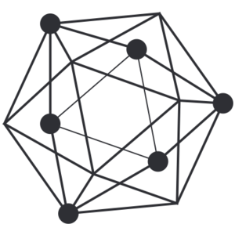
Blockchain evolution (2009-present)
A hard-coded cryptocurrency application
w. limited stack-based scripting language
Proof-of-work-consensus
Native cryptocurrency (BTC)
Permissionless blockchain system
2009
Bitcoin
Blockchain 1.0
Distributed applications (smart contracts)
in a domain-specific language (Solidity)
Proof-of-work-consensus
Native cryptocurrency (ETH)
Permissionless blockchain system
2014
Ethereum
Blockchain 2.0
2017
Hyperledger
Fabric
Distributed applications (chaincodes)
in different general-purpose languages
(e.g., golang, Java, Node)
Modular/pluggable consensus
No native cryptocurrency
Multiple instances/deployments
Permissioned blockchain system
Blockchain 3.0

Slide 6

Hyperledger Fabric – key requirements
No native cryptocurrency
Ability to code distributed apps in general-purpose languages
Modular/pluggable consensus
Satisfying these requirements required
a complete overhaul of the (permissioned) blockchain design!
end result
Hyperledger Fabric v1
http://github.com/hyperledger/fabric
Open source, Apache 2.0 license

Slide 7
Blockchain Architecture
101

Slide 8
Permissionless Blockchains
A =hash of block #236
B = Root hash of
Merkle tree of tx
hashes
C = nonce
Block #237
Transactions
(payload)
PoW Consensus
Block “mining”
Block #237 propagation to the network
(gossip)
Block Validation / Smart Contract Execution (every miner)
Validating (executing) transactions in the payload
Verifying hash of Block #237 < DIFFICULTY
…
#234
#235
#236
Validating (executing) transactions in the payload
Finding nonces such that
h = hash of Block #237 = SHA256(A||B||C) < DIFFICULTY
ORDER→ EXECUTE architecture
Nodes execute smart-contracts after consensus (PoW)
Miner of block #237
A =hash of block #236
B = Root hash of
Merkle tree of tx
hashes
C = nonce
Block #237
Transactions
(payload)
…
#234
#235
#236

Slide 9
Permissioned Blockchain 2.0 architecture
Seq #24
View no
Tx1
Tx3
Tx2
Tx4
Node A (leader)
Node B
ORDER→ EXECUTE architecture
Active state machine replication [Schneider90]
Inputs to the state machine (smart contract txs) are totally ordered
Executed in sequence, after consensus (ordering)
ALL permissioned blockchains are architected like this until Fabric v1
Node C
Node D
example:
PBFT [Castro/Liskov02]
…
#234
#235
#236
Seq #24
View no
Tx1
Tx3
Tx2
Tx4
Execute tx

Slide 10
What are the issues with
ORDER → EXECUTE
architecture?

Slide 11

ORDER → EXECUTE architecture issues (Blockchain 2.0)
Sequential execution of smart contracts
long execution latency blocks other smart contracts, hampers performance
DoS smart contracts (e.g., infinite loops)
How Blockchain 2.0 copes with it:
Gas (paying for every step of computation))
Tied to a cryptocurrency
Non-determinism
Smart-contracts must be deterministic (otherwise – state forks)
How Blockchain 2.0 copes with it:
Enforcing determinism: Solidity DSL, Ethereum VM
Cannot code smart-contracts in developers favorite general-purpose language (Java, golang, etc)
Confidentiality of execution: all nodes execute all smart contracts
Inflexible consensus: Consensus protocols are hard-coded

Slide 12
Hyperledger Fabric v1
Architecture
http://github.com/hyperledger/fabric

Slide 13
HLF v1 architecture in one slide
Existing blockchains’ architecture
input tx tx against smart contracts
Hyperledger Fabric v1 architecture
EXECUTE → ORDER → VALIDATE
Application consists of two components:
Chaincode (execution code)
Endorsement policy (validation code)

Slide 14
Hyperledger Fabric v1 Transaction flow
Total order semantics
(ordering service)
1
<PROPOSE, clientID, chaincodeID, txPayload, timestamp, clientSig>
3
BROADCAST(blob)
2
<TX-ENDORSED, peerID, txID, chaincodeID, readset, writeset>
4
DELIVER(seqno,prevhash,block)
1
Collect endorsement
(“sufficient” no. of
TX-ENDORSED Msgs)
Simulate/Execute tx
Sign TX-ENDORSED
2
broadcast(endorsement)
Ordering service (consensus)
3
4
client (C)
endorsing
peer (EP1)
endorsing
peer (EP2)
endorsing
peer (EP3)
orderers

Slide 15
Hyperledger Fabric v1 Transaction flow
Total order semantics
(ordering service)
1
<PROPOSE, clientID, chaincodeID, txPayload, timestamp, clientSig>
3
BROADCAST(blob)
2
<TX-ENDORSED, peerID, txID, chaincodeID, readset, writeset>
4
DELIVER(seqno,prevhash,block)
1
Collect endorsement
(“sufficient” no. of
TX-ENDORSED Msgs)
Simulate/Execute tx
Sign TX-ENDORSED
2
broadcast(endorsement)
Ordering service (consensus)
3
4
4
client (C)
endorsing
peer (EP1)
endorsing
peer (EP2)
endorsing
peer (EP3)
(committing)
peer (CP4)
(committing)
peer (CP5)
orderers

Slide 16
Hyperledger Fabric v1 Transaction flow
Total order semantics
(ordering service)
1
<PROPOSE, clientID, chaincodeID, txPayload, timestamp, clientSig>
3
BROADCAST(blob)
2
<TX-ENDORSED, peerID, txID, chaincodeID, readset, writeset>
4
DELIVER(seqno,prevhash,block)
1
Collect endorsement
(“sufficient” no. of
TX-ENDORSED Msgs)
Simulate/Execute tx
Sign TX-ENDORSED
2
broadcast(endorsement)
Ordering service (consensus)
3
4
4
client (C)
endorsing
peer (EP1)
endorsing
peer (EP2)
endorsing
peer (EP3)
(committing)
peer (CP4)
(committing)
peer (CP5)
orderers

Slide 17
Hyperledger Fabric v1 Transaction flow
Total order semantics
(ordering service)
1
<PROPOSE, clientID, chaincodeID, txPayload, timestamp, clientSig>
3
BROADCAST(blob)
2
<TX-ENDORSED, peerID, txID, chaincodeID, readset, writeset>
4
DELIVER(seqno,prevhash,block)
1
Collect endorsement
(“sufficient” no. of
TX-ENDORSED Msgs)
Simulate/Execute tx
Sign TX-ENDORSED
2
Sufficiently enough to satisfy
Endorsement
Policy (EP)
Ordering service (consensus)
3
4
4
Validate(endorsement,
chaincodeID,
EP)
Validate(readset)
Commit tx
Validate(endorsement,
chaincodeID,
EP)
Validate(readset)
Commit tx
client (C)
endorsing
peer (EP1)
endorsing
peer (EP2)
endorsing
peer (EP3)
(committing)
peer (CP4)
(committing)
peer (CP5)
orderers

Slide 18
Challenge #1: Non-Determinism
Goals
Enabling chaincodes in golang, Java, … (can be non-deterministic)
While preventing state-forks due to non-determinism
Hyperledger Fabric v1 approach
Execute chaincode before consensus
Non-deterministic chaincode execution is tolerated
Use consensus to agree on propagation of versioned state-updates
EXECUTE→ORDER→VALIDATE:
non-deterministic tx are not guaranteed to be live
(e.g., cannot collect endorsement due to non-determinism)
ORDER→EXECUTE
non-deterministic tx are not guaranteed to be safe (forks can occur)

Slide 19
Challenge #2: Sequential execution of smart-contracts
Goals
Prevent slow smart-contracts from delaying the system
Address DoS without native cryptocurrency
Hyperledger Fabric v1 approach
Partition execution of smart-contracts
Only a subset of peers are endorsers for a given smart-contract (chaincode)
DoS, resource exhaustion?
HLF v1 transaction flow is resilient to non-determinism
Endorsers can apply local policies (non-deterministically) to decide when to abandon the execution of a smart-contract
No need for gas/cryptocurrency!

Slide 20
Challenge #3: Confidentiality of execution
Goal
Not all nodes should execute all smart contracts
Hyperledger Fabric v1 approach
Partition execution of smart-contracts
Only a subset of peers are endorsers for a given smart-contract (chaincode)
Confidentiality of data (versioned updates) is not yet addressed
Support for ZKP-based data confidentiality in progress

Slide 21
Challenge #4: Consensus modularity/pluggability
Honeybadger
Ouroboros
Algorand
Open research problem:
Given the use case, network, no. of nodes
What is the most suitable Blockchain consensus?
M. Vukolić. The Quest for Scalable Blockchain Fabric:Proof-of-Work vs. BFT Replication
In Open Problems in Network Security Workshop, 2015.

Slide 22
Challenge #4: Consensus modularity/pluggability
Goal
No-one-size-fits-all consensus → Consensus protocol must be modular and pluggable
Hyperledger Fabric v1 approach
Fully pluggable consensus (was present in order-execute v0.6 design as well)
HLF v1 consensus (ordering service) implementations, Nov 2017
Centralized! (SOLO, mostly for development and testing)
Crash FT (KAFKA, thin wrapper around Kafka/Zookeeper)
Proof of concept BFT
BFT-SMaRt library (University of Lisbon, September 2017)
Code: https://github.com/jcs47/hyperledger-bftsmart
Paper: https://arxiv.org/abs/1709.06921
«Native» BFT implementation targeting about 100 orderers – in progress
Many more to come (TBC)
Hybster SGX Consensus (TU Braunschweig, Eurosys 2017), Honeybadger BFT (UIUC, CCS’16, Stanford), XFT (IBM, OSDI’16)
Perhaps also your new, great blockchain consensus?

Slide 23

Fabric Validation – Endorsement Policies
Deterministic (!) programs used for validation
Executed by all peers post-consensus
Cannot be deployed/installed by untrusted application developers
Unlike chaincode
Can only be parametrized by application developers
Examples
K out of N chaincode endorsers need to endorse a tx
Alice OR (Bob AND Charlie) need to endorse a tx
Fabcoin – Bitcoin-inspired UTXO authority-minted cryptocurrency for Fabric

Slide 24
Fabric Hybrid Execution Model
Endorsement Policy can, in principle, implement arbitrary program
EXECUTE → ORDER → VALIDATE approach of Fabric v1
splits execution in two parts
EXECUTE (chaincode) → executed pre-consenus → can be non-deterministic
VALIDATE(endorsement policy) → evaluated post-consenus → must be deterministic
HLF v1 mixes
passive and active replication
into hybrid replication

Slide 25
We skipped many details
Membership Service Provider (and CAs), Chaincode details, Gossip, Ledger design, Channels
Further reading
https://arxiv.org/abs/1801.10228
Fabric systems paper incl. Fabcoin, out today!
http://hyperledger-fabric.readthedocs.io/en/latest/ - official docs

Slide 26

Hyperledger Project
and
Fabric Use Cases
(very briefly)

Slide 27


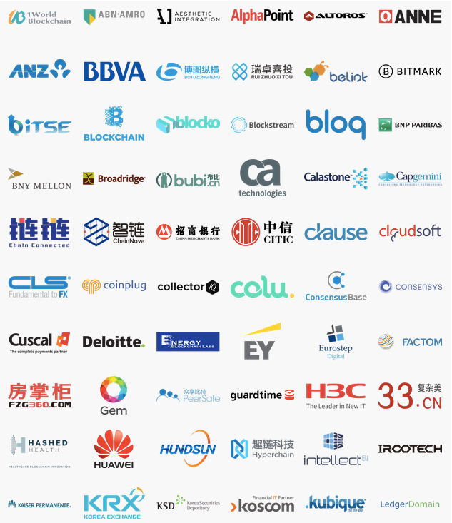
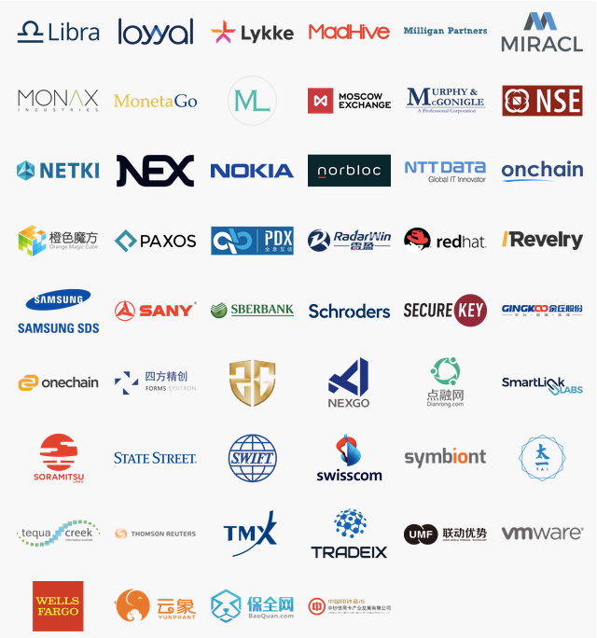

Hyperledger members
Premier
General
Associate
Source: https://www.hyperledger.org/about/members
Updated 21 August 2017
Notes:
Hyperledger is the fastest growing project in Linux Foundation history and has a huge amount of industry support.

Slide 28































Over 400 prototypes, engagements and multiple active networks
Trade Finance | Pre and Post Trade | Complex Risk Coverage
Identity/ Know your customer (KYC) | Unlisted Securities/ Private Equity Funds | Loyalty Program
Medicated Health Data Exchange | Fraud/ Compliance Registry | Distributed Energy/ Carbon Credit
Supply Chain | Food Safety | Provenance/ Traceability
Notes:
IBM brings the experience of over 400+ Client engagements and multiple active networks at your ecosystems fingertips.
The IBM Blockchain Platform puts the experience of over 400+ Client engagements and multiple active networks at your ecosystems fingertips.
IBM has a large and increasing number of public references on blockchain.
COMPLETE LIST with references is here > http://ibm.biz/BlockPubRef
Northern Trust:
http://www-03.ibm.com/press/us/en/pressrelease/51655.wss
Maersk:
http://www-03.ibm.com/press/us/en/pressrelease/51712.wss
HSBC, Bank of America, IDA:
http://www.coindesk.com/hsbc-bank-america-blockchain-supply-chain/
ABN AMRO:
https://www.abnamro.com/en/newsroom/blogs/arjan-van-os/2016/walking-the-walk-exploring-the-power-of-blockchain.html
Crédit Mutuel Arkéa:
http://www.coindesk.com/ibm-completes-blockchain-trial-french-bank-credit-mutuel/
JPX:
http://www.ibm.com/press/us/en/pressrelease/49088.wss
Kouvola Innovation:
http://www.ibm.com/press/us/en/pressrelease/49029.wss
London Stock Exchange:
http://www.ibtimes.co.uk/linux-foundation-blockchain-consortium-digital-asset-ibm-credits-london-stock-exchange-board-1533798
Mizuho:
http://www.coindesk.com/mizuho-digital-currency-powered-blockchain-settlement/
IBM Global Finance:
http://www.coindesk.com/ibm-building-blockchain-dispute-resolution-system/
Everledger
https://www-03.ibm.com/press/us/en/pressrelease/50169.wss
Bank of Tokyo Mitsubishi
https://www-03.ibm.com/press/us/en/pressrelease/50544.wss
China UnionPay
http://www.coindesk.com/ibm-china-unionpay-blockchain-loyalty-exchange/
CLS
http://www.coindesk.com/cls-to-develop-blockchain-payment-service-on-ibm-fabric/
UBS
http://www.coindesk.com/ubs-blockchain-prototype-trade/
IBM GF: http://www.coindesk.com/ibm-building-blockchain-dispute-resolution-system/

Slide 29
Further reading from IBM Research - Zurich
Fabric v1
Andoulaki et al.. “Hyperledger Fabric: a Distributed Operating System for Permissioned Blockchains”, 2018.
https://arxiv.org/abs/1801.10228
On blockchain consensus out there...
C. Cachin, M. Vukolić. “Blockchain Consensus Protocols in the Wild”, DISC 2017.
Why we re-architected Fabric v1? (short-version)
M. Vukolić. “Rethinking Permissioned Blockchains”, BCC 2017.
On non-determinism
C. Cachin, S. Schubert, M. Vukolić. “Non-determinism in Byzantine fault-tolerant replication”, OPODIS 2016.
New consensus protocols (and fault models)
S. Liu, P. Viotti, C. Cachin, V. Quema, M. Vukolic. “XFT: Practical Fault-Tolerance Beyond Crashes”, OSDI 2016.
Pushing (crash tolerant) consensus over 3 million tps
Z. Istvan, D. Sidler, G. Alonso, M. Vukolić. “Consensus in a box: Inexpensive coordination in hardwar”, NSDI’16.
PoW vs BFT consensus
M. Vukolić. “The Quest for Scalable Blockchain Fabric: PoW vs BFT replication”, iNetSec 2015.

Slide 30
Thank You!

Slide 31
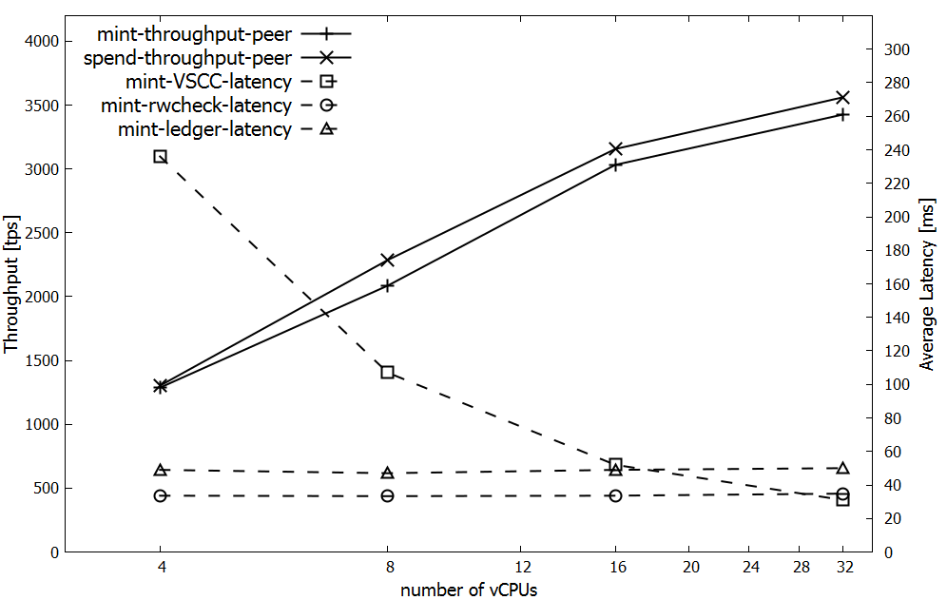
Fabric/Fabcoin performance

